Slide 1

Solar cell materials:
simulation, optical and photoelectric characterization
Prof. Serhiy KONDRATENKO
Department of Optics, Faculty of Physics, Taras Shevchenko National University of Kyiv
Prof. Oleg OLYKH
General Physics Department, Faculty of Physics, Taras Shevchenko National University of Kyiv)
1st Workshop Green Energy Technologies for the Future

Slide 2
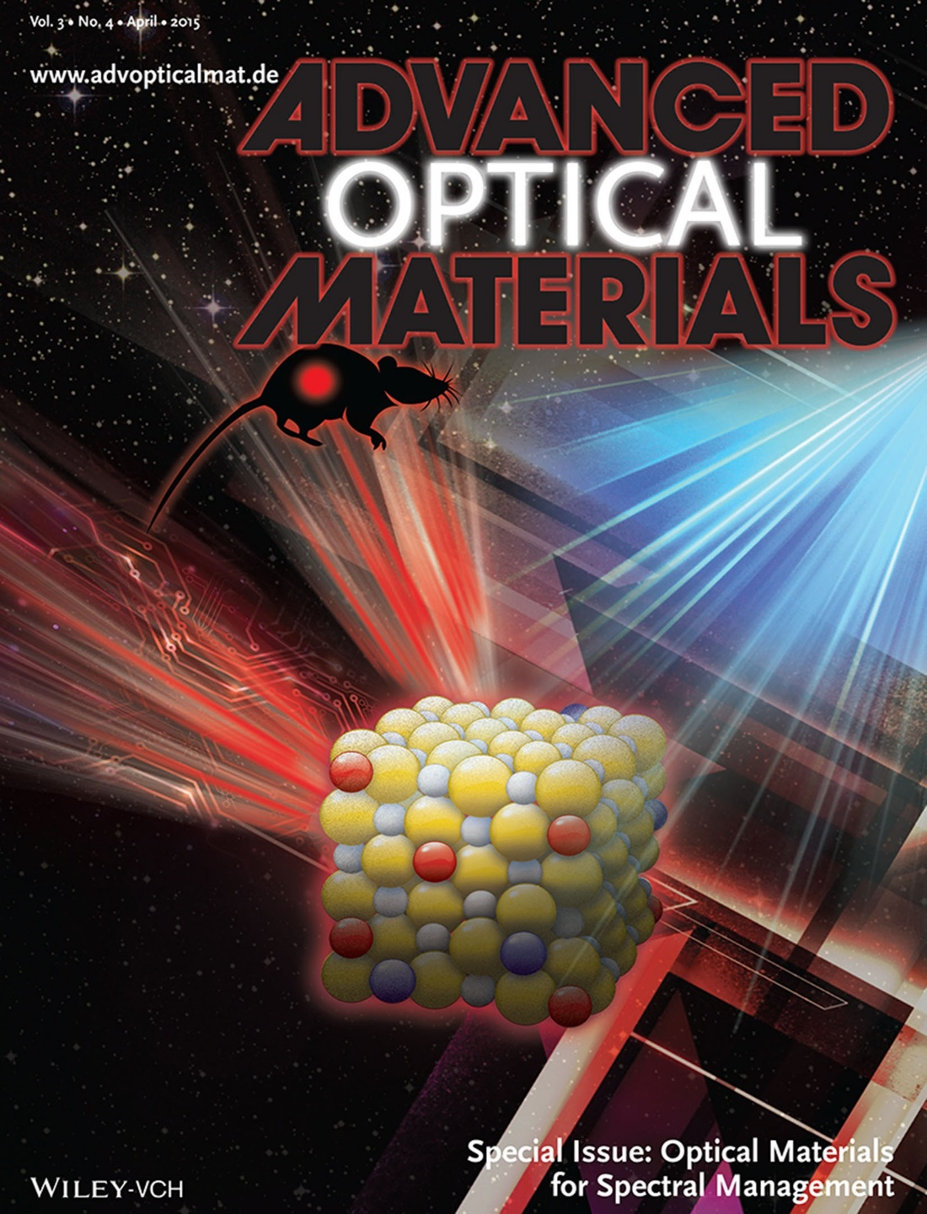
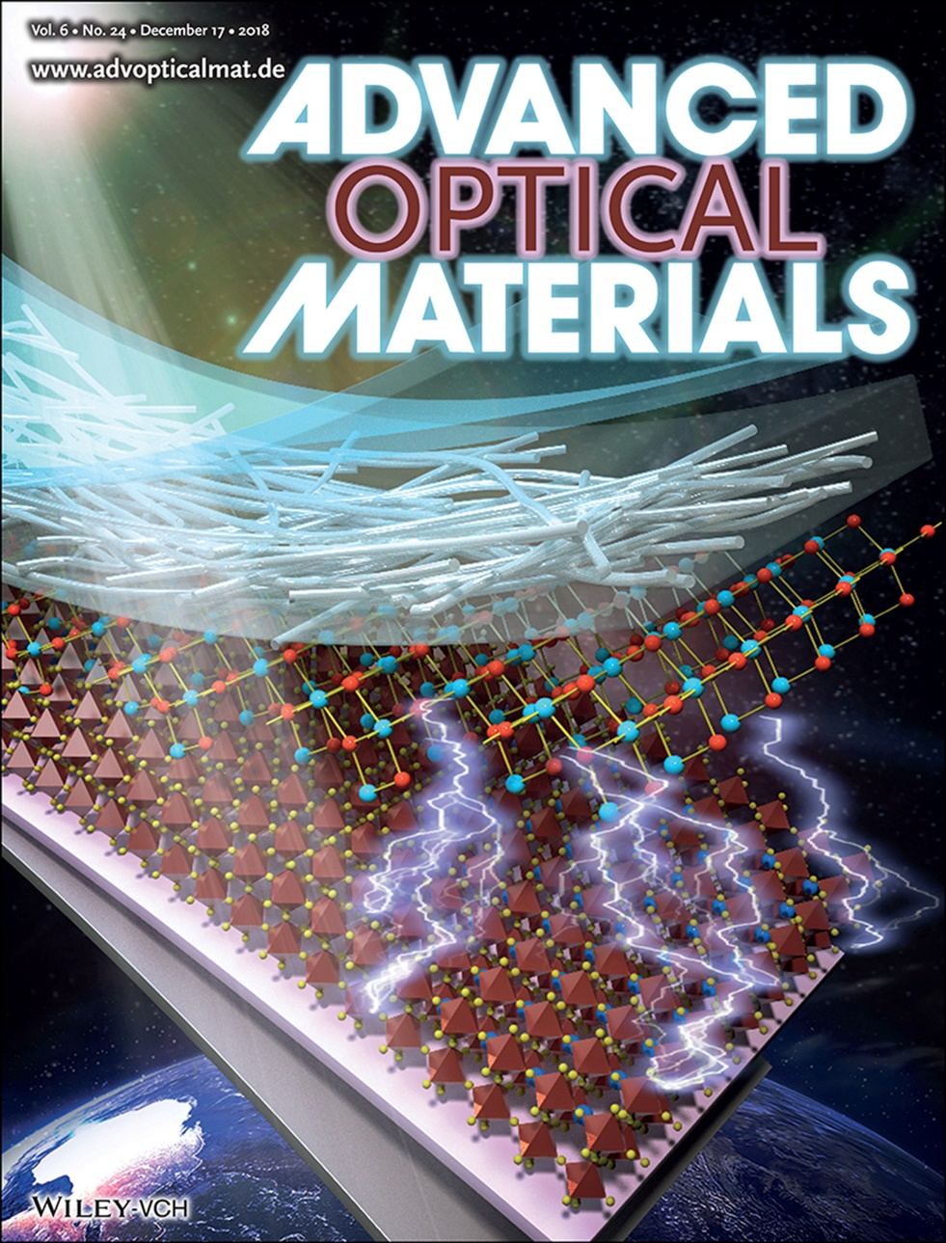
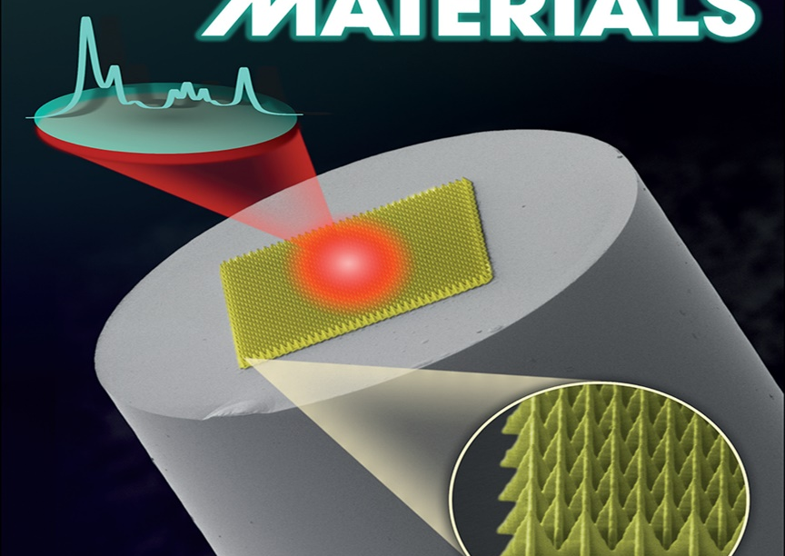
Group of Optical diagnostics of semiconductor materials
Prof. Serhiy Kondratenko
1st Workshop Green Energy Technologies for the Future

Slide 3
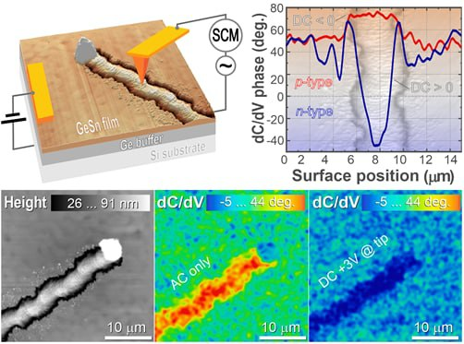
Group Research topics
Solar cells and IR Photodetectors
Physics of Low-Dimensional Systems
Photoconductivity of Semiconductor Heterostructures
1st Workshop Green Energy Technologies for the Future

Slide 4
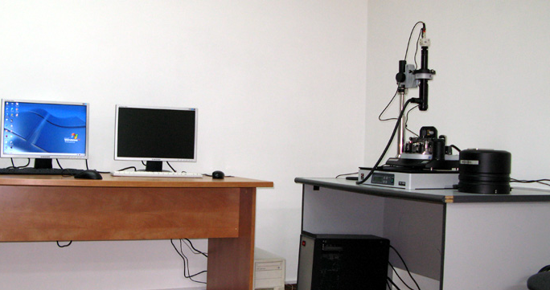
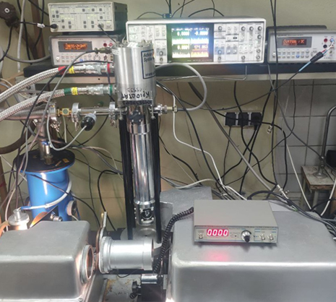
Experimental facilities
Semiconductor characterization setup
AFM and Kelvin Probe Force Microscopy
Photoelectric and Photoluminescence spectroscopy
Photoconductivity transients and thermally stimulated conductivity
Transport measurements
Temperature range:
10-400K
Spectral range
0.25-10 μm
pA low current sensitivity
Lock-in amplifier low noise detection
Sample preparation and other characterization facilities
Spin and spray coating thin film deposition
Spectral ellipsometry
Optical transmission and absorption spectroscopy
1st Workshop Green Energy Technologies for the Future

Slide 5
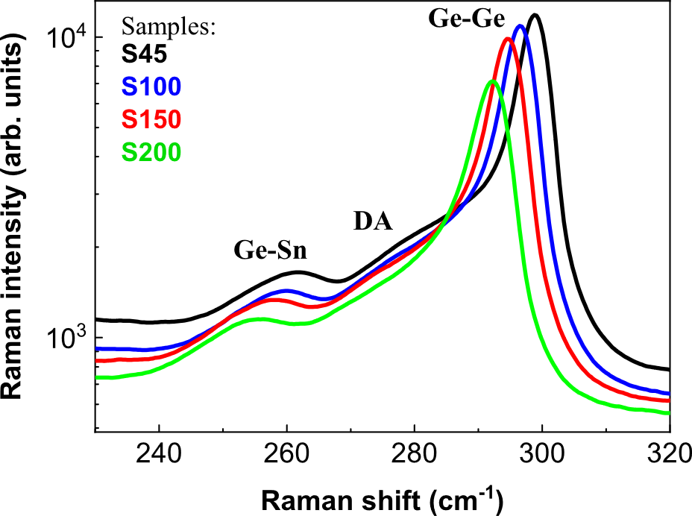
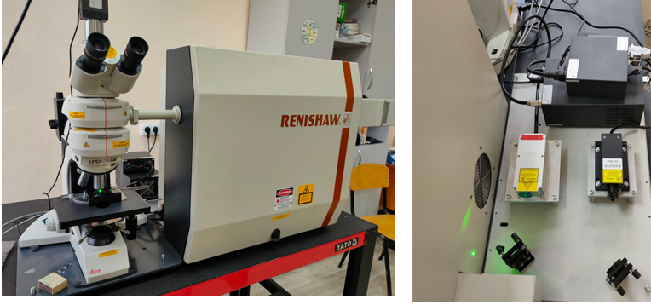
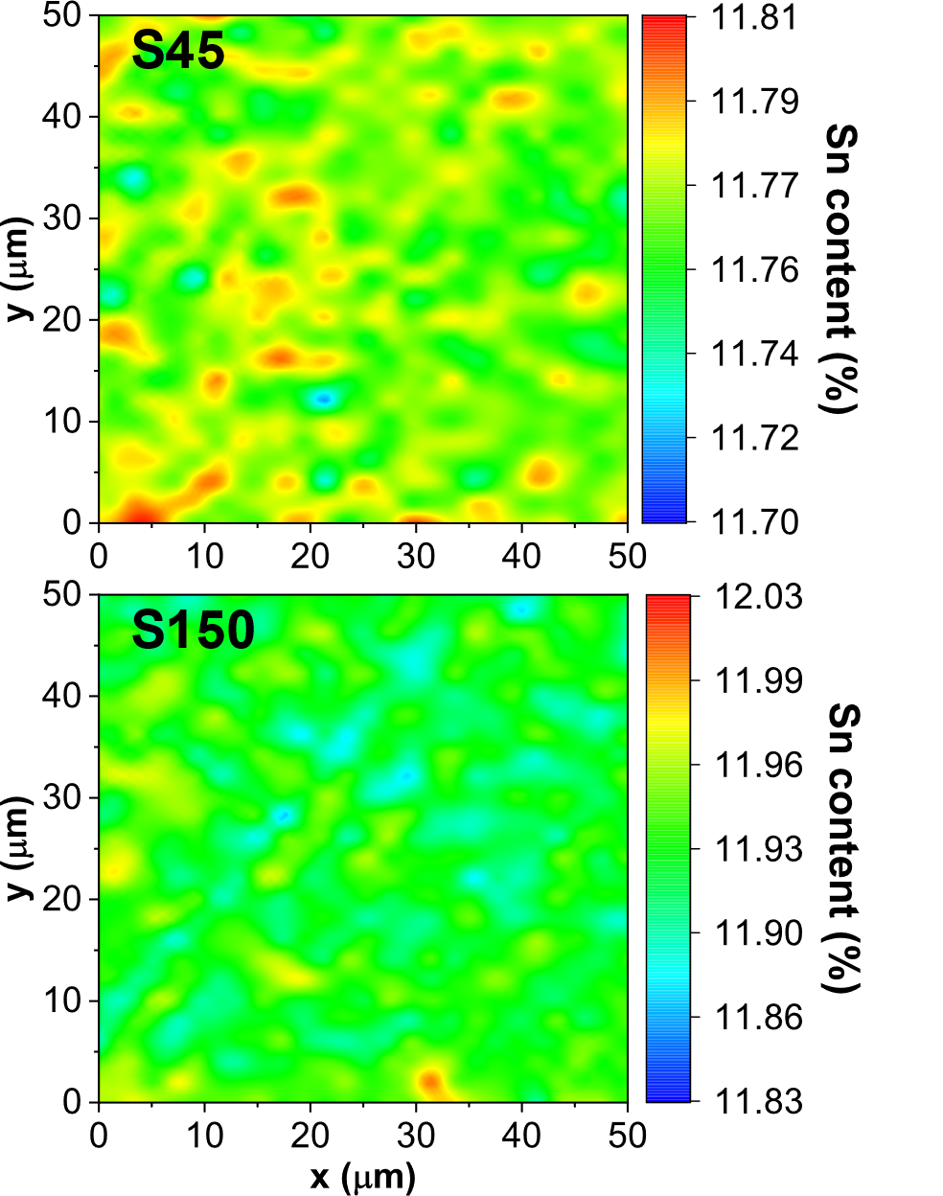
Optical diagnostics of solar cell materials
Raman Spectroscopy
1st Workshop Green Energy Technologies for the Future

Slide 6
Ongoing projects
Innovative Solar Cells NATO project (2021-2025)
in collaboration with
Lashkaryov Institute of Semiconductor Physics NASU (ISP NASU), Kyiv, Ukraine (Prof. Dr. Alexei Nazarov)
Université catholique de Louvain, Louvain-la-Neuve, Belgium (Prof. Dr. Denis Flandre)
Development of advanced thin film optoelectronic materials based on coupled
hybrids of quantum dot and two-dimensional nanostructures
National Research Foundation of Ukraine (2020-2023)
Completed project
GeSn alloys for improved current generation and charge carrier collection in tandem solar cell
CRDF Global (2020-2021)
in collaboration with Arkansas Institute for Nanoscience and Engineering, University of Arkansas
(Prof. Dr. Gregory Salamo)
1st Workshop Green Energy Technologies for the Future

Slide 7
Photoluminescence and photovoltage spectroscopy
1st Workshop Green Energy Technologies for the Future

Slide 8
Photoconductivity spectroscopy
Photoexcitation
Epitaxial layers
Substrate
Analyzer
1st Workshop Green Energy Technologies for the Future

Slide 9
Photoconductivity transients
Life-time of photogenerated electron hole pairs
1st Workshop Green Energy Technologies for the Future

Slide 10
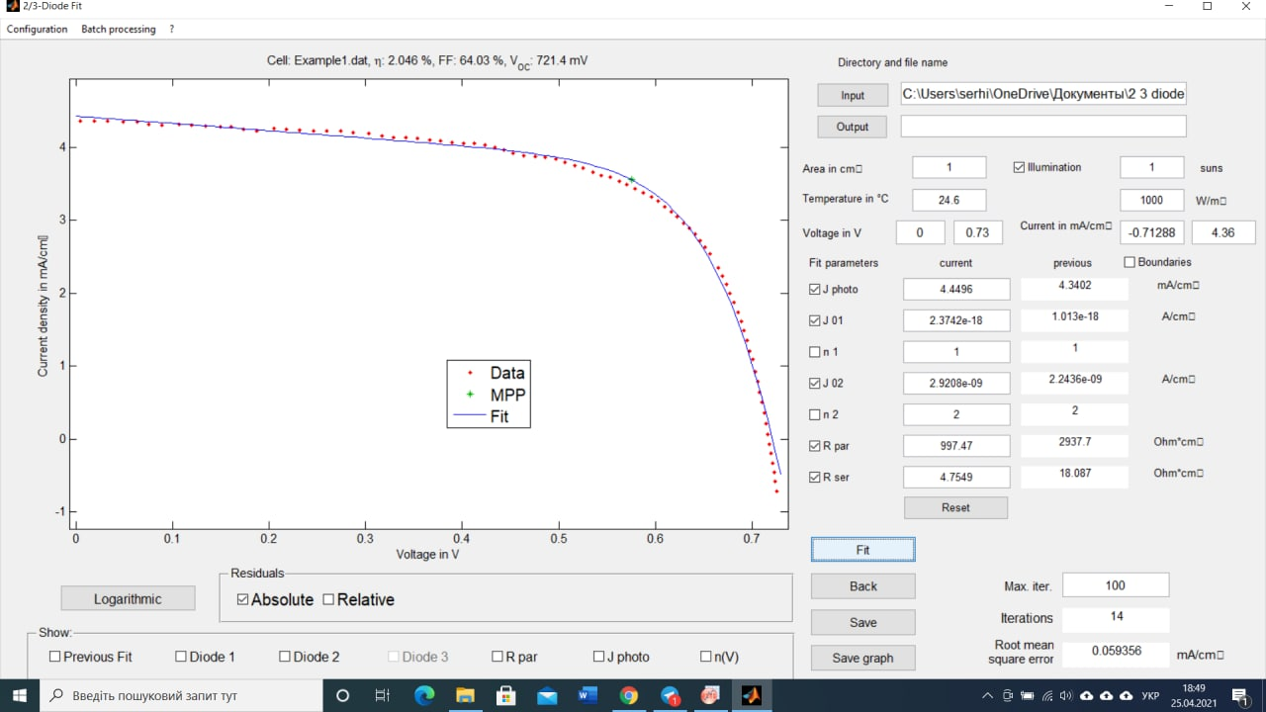
J-V measurements and simulations
Performing of the solar cell parameters simulations :
Open-circuit voltage, and short-circuit current
Power conversion efficiency
J-V and energy structure simulations
Serial resistance and fill factors
Parasitic shunt resistance
2/3 Diode Fit
1st Workshop Green Energy Technologies for the Future

Slide 11
Simulations of band diagram and parameters of solar cells
25
20
15
10
5
0
Position (nm)
0
10 20 30 40
Position (nm)
1st Workshop Green Energy Technologies for the Future

Slide 12
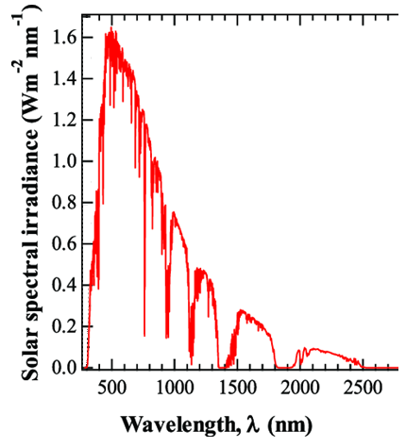
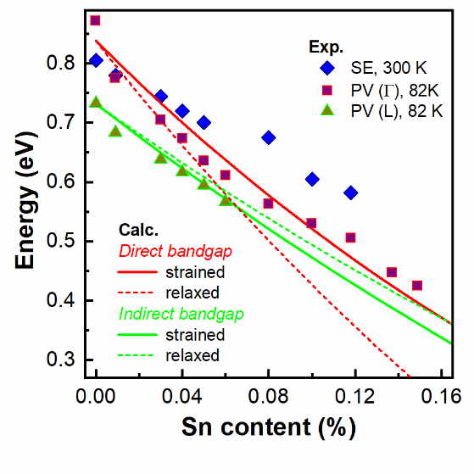
2020 U.S.-Ukraine Alternative Energy Research Competition
Energy that can be used by a GeSn alloys
Compositional dependencies of the
direct and indirect bandgaps of GeSn
Si
Ge
GeSn
Ge_{1-x}Sn_{x}
Ge
Si substrate
Transparent conductive PEDOT:PSS
Ge_{1-x}Sn_{x} (direct bandgap 0.3 – 0.8 eV)
Ge (indirect bandgap 0.67 eV)
Si (indirect bandgap 1.12 eV)
1st Workshop Green Energy Technologies for the Future

Slide 13
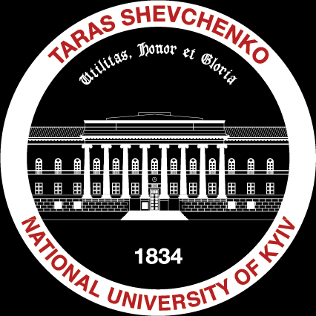
Prof. Dr. Serhiy Kondratenko
Taras Shevchenko National University of Kyiv
Division of Optics
64/13, Volodymyrska Street, City of Kyiv, Ukraine, 01601
Kondratenko@knu.ua
Taras Shevchenko National University of Kyiv, 2023

